Slide 1
Final Seminar Report
Group 2, Dec 11

Slide 2
Table of Contents
01
01 Data Preparation
02 Feature Sets Selection
03 Hyper-parameter Optimization
04 Future Work

Slide 3
01
Data Preparation

Slide 4
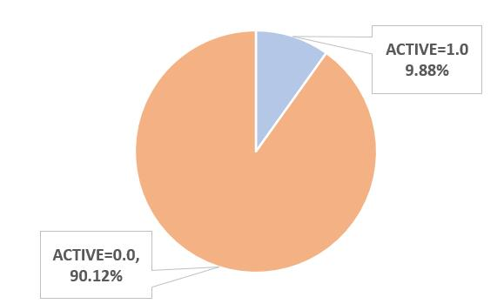
Raw Data Sample
Label Distribution
Imbalanced Data
*Only around 10% compounds’ labels are “ACTIVE”.
*Influences:
(1) The sampling for Trees Generation -> Some parameter’s tuning
(2) Evaluation index -> AUC instead of Accuracy

Slide 5
Data Separation
validation_data: 16%
training_data: 64%
test_data: 20%
Iteration 1
Iteration 2
Iteration 3
Iteration 4
Iteration 5
Fig. 1 k-folds(k=5) Cross-validation on Dataset

Slide 6
02
Feature Sets Selection

Slide 7
Basic Features of Chemical Compounds
GetNumAtoms( )--Number of atom
CalcExactMolWt( )--Molecular weight
fr ArN( )--Number of N functional groups attached to aromatice
fr halogen( ) --Number of halogens
Lipinski.NumAliphaticRings( )--Number of aliphatic rings for a molecule
Lipinski.NumAromaticRings( )--Number of aromatic rings for a molecule

Slide 8
Three Kinds of Fingerprints
 | Description | Parameters | Shape
ECFP* | Based on atom properties | (radius=2, nbits=124) | (, 124), ndarray
FCFP* | Based on pharmacophoric properties | (radius=2, nbits=124, useFeatures=True) | (, 124) , ndarray
mol2Vec | Based on word2vec |  | (, 300), ndarray
*Extended Connectivity Fingerprints
*Functional-Class Fingerprints

Slide 9
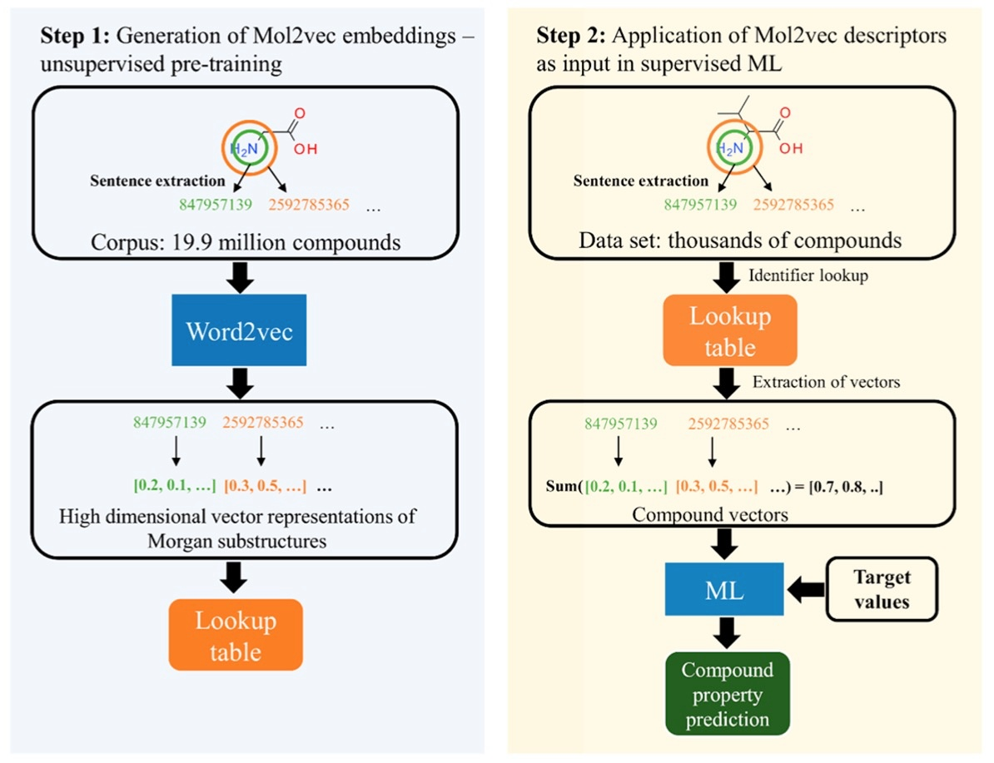
Mol2vec*
*Mol2vec is an unsupervised machine learning approach to learn vector representations of molecular substructures.
Notes:
Mol2vec is an unsupervised machine learning approach to learn vector representations of molecular substructures.
It is a new idea borrowing from natural language processing techniques Like the Word2vec models. Words of close relationship in documents are also in close proximity in the vector space, when they are represented in a form of vector. In the similar way, Mol2vec can learns vector representations of molecular substructures that point in similar directions for chemically related substructures. Compounds, are like words, can finally be encoded as vectors by summing the vectors of the individual substructures. After that, these vectors can be fed into machine learning models to train and predict compound properties.

Slide 10
Baseline
 | Random Forest | lightGBM | XGBM
Basic | 0.587 | 0.640 | 0.627
FCFP | 0.798 | 0.741 | 0.682
ECFP | 0.784 | 0.740 | 0.687
m2v | 0.761 | 0.764 | 0.726
Basic + FCFP | 0.799 | 0.753 | 0.694
Basic + ECFP | 0.796 | 0.744 | 0.696
Basic + m2v | 0.773 | 0.773 | 0.732
Basic + FCFP + ECFP | 0.812 | 0.772 | 0.715
ALL | 0.786 | 0.784 | 0.741

Slide 11
Feature Selection
Model: Random Forest Feature Set: { basic+ECFP+FCFP }
Feature Importance:
* We ran the PCA and only one column of feature was dropped.

Slide 12
Hyper-parameter Optimization
03

Slide 13
Hyper-tuning in Random Forest
Model: Random Forest Feature Set: { basic+ECFP+FCFP }
{ 'class_weight': ['balanced_subsample']*,
'criterion': ['entropy'],
'max_depth': [30, 40],
'n_estimators': [225, 250, 300, 350, 400],
'oob_score': [True] }
Grid Search for the best parameters combination.
8 groups of parameters with 5-folds cross-validation in total.
*This parameter can help deal with the imbalanced data.

Slide 14
Hyper-tuning in Random Forest
Table: The performance(AUC) of Random Forest on 5-folds Cross-validation with different parameters
max_depth | n_estimators | split0_test_score | split1_test_score | split2_test_score | split3_test_score | split4_test_score | mean_test_score | std_test_score
30 | 225 | 0.8186 | 0.8071 | 0.8139 | 0.8136 | 0.8182 | 0.8143 | 0.00415681
30 | 300 | 0.8218 | 0.8137 | 0.8160 | 0.8180 | 0.8229 | 0.8185 | 0.00346156
30 | 400 | 0.8259 | 0.8147 | 0.8171 | 0.8211 | 0.8216 | 0.8201 | 0.00385479
40 | 225 | 0.8196 | 0.8098 | 0.8150 | 0.8164 | 0.8190 | 0.8160 | 0.00352462
40 | 300 | 0.8255 | 0.8100 | 0.8159 | 0.8176 | 0.8194 | 0.8177 | 0.00502906
40 | 400 | 0.8269 | 0.8100 | 0.8172 | 0.8192 | 0.8238 | 0.8194 | 0.00581308
30 | 250 | 0.824 | 0.810 | 0.814 | 0.819 | 0.821 | 0.818 | 0.00480932
30 | 350 | 0.827 | 0.812 | 0.819 | 0.824 | 0.824 | 0.821 | 0.0051482
40 | 350 | 0.827 | 0.814 | 0.819 | 0.819 | 0.824 | 0.820 | 0.00473505
40 | 250 | 0.822 | 0.807 | 0.817 | 0.816 | 0.820 | 0.816 | 0.00521445

Slide 15
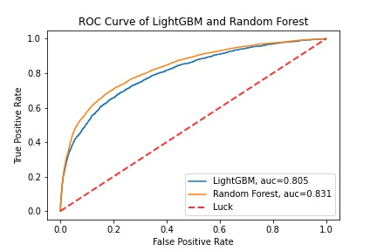
Model Comparison
Figure: The performance(AUC) comparison of Random Forest and lightGBM with their relative best feature sets

Slide 16
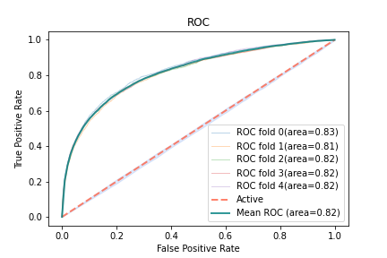
Hyper-tuning in Random Forest
{ 'class_weight': 'balanced_subsample',
'criterion': 'entropy']
'max_depth': 30,
'n_estimators': 400]
'oob_score': True }
Figure: The performance(AUC) of Random Forest on 5-folds Cross-validation with the final parameters

Slide 17
04
Future Work

Slide 18
Future Work
Consider to combine the results outputted by multiple models.
Consider the possible prediction based on the data structure or images of chemical compounds.

Slide 19
References
[1] “Rdkit,” https://www.rdkit.org/, accessed December 9, 2020.
[2] D. E. Ratnawati, Marjono, and S. Anam, “Prediction of active compounds from smiles codes using backpropagation algorithm,” in AIP Conference Proceedings, vol. 2021, no. 1. AIP Publishing LLC, 2018, p. 060009.
[3] “Computing extended connectivity fingerprints,” https://depth-first.com/articles/2019/01/11/ extended-connectivity-fingerprints/, accessed December 9, 2020.
[4] S. Jaeger, S. Fulle, and S. Turk, “Mol2vec: unsupervised machine learning approach with chemical intuition,” Journal of chemical information and modeling , vol. 58, no. 1, pp. 27–35, 2018.
[5] “Open source ecfp/fcfp circular fingerprints in cdk,” https://cheminf20.org/2014/02/21/ open-source-ecfpfcfp-circular-fingerprints-in-cdk/, accessed December 9, 2020.
[6] D. Weininger, A. Weininger, and J. L. Weininger, “Smiles. 2. algorithm for generation of unique smiles notation,” Journal of chemical information and computer sciences , vol. 29, no. 2, pp. 97–101, 1989.

Slide 20
Q & A

Slide 21
Thank you!

